Slide 1
What are P, NP, NP-Complete, and NP-Hard?
Two models of computer :
  Deterministic and non-deterministic.
    A deterministic computer is the regular computers which we are using.
    A non-deterministic computer is one that has unlimited parallelism.

Slide 2
In deterministic machine each computation can be viewed as a linear ordered sequence (finite or infinite) of computations.
Nondeterministic machines are not restricted to such ordered computations. At each moment, it will be allowed to choose among a number of possibilities. Each computation corresponding to a particular sequence of choices is called a computation.

Slide 3
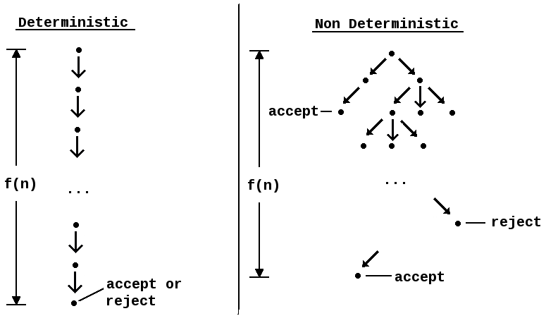

Slide 4
P is the set of all decision problems solvable by deterministic algorithms in polynomial time.
  Polynomial time: O(n²), O(n³), O(1), O(n lg n)
  Not in polynomial time: O(2^{n}), O(n^{n}), O(n!)
NP is the set of all the set of all decision problems solvable by non-deterministic algorithms in polynomial time.
Since deterministic algorithms are just a special case of nondeterministic ones, we conclude that P is a subset of NP

Slide 5
Most problems that can not be solved in polynomial-time algorithms are either optimization or decision problems.
Optimization Problems
  An optimization problem is one which asks, “What is the optimal solution to problem X?”
  Examples:
    0-1 Knapsack
    Fractional Knapsack
    Minimum Spanning Tree
Decision Problems
  An decision problem is one with yes/no answer
  Examples:
    Does a graph G have a MST of weight ≤ W?
    Is there a hamiltonian cycle of weight ≤ k

Slide 6
NP
P
Commonly believed relationship between P and NP

Slide 7
Sample Problems in P
Fractional Knapsack
MST
Sorting
Others?

Slide 8
Sample Problems in NP
Fractional Knapsack
MST
Sorting
Others?
  Hamiltonian Cycle (Traveling Salesman)
  Graph Coloring

Slide 9
The most famous unsolved problem in computer science is whether P=NP or P ≠ NP

Slide 10
Reducibility
  Problem L1 reduces to L2 if and only if there is a way to solve L1 by a deterministic polynomial time algorithm using a deterministic algorithm that solves L2 in polynomial time.
  It is represented as L1 α L2
  This definition implies that if we have a polynomial time algorithm for L2, then we can solve L1 in polynomial time.

Slide 11
NP-Complete
Q is an NP-Complete problem if:
1) Q is in NP
2) every other NP problem polynomial time
reducible to Q
Note: Q is the hardest problem in this group.

Slide 12
NP-Hard
A problem is NP-hard if and only if it’s at least as hard as an NP-complete problem.

Slide 13
Commonly believed relationship among p, NP, NP-Complete, and NP-Hard problems

Slide 14
Normally decision problems are NP-Complete.
Optimization problems are NP-Hard.
There are some NP-Hard problems that are not NP-Complete. For example, halting problem. The halting problem states that: “ Is it possible to determine whether an algorithm will ever halt or enter in loop on certain input?
Two problems P and Q are said to be polynomially equivalent iff P α Q and Q α P.
A problem L is ______ if and only if satisfiability reduces to L.
  Ans: NP-Hard ( it is theorem in book, verify …………… )

Slide 15
Cook’s Theorem
It States that satisfiability is in p iff P=NP
Boolean Satisfiability( SAT ) problem is NP Complete. ( see DDA A.A.Puntambekar )

